Slide 1

AMAZON SALES PROJECT

Slide 2
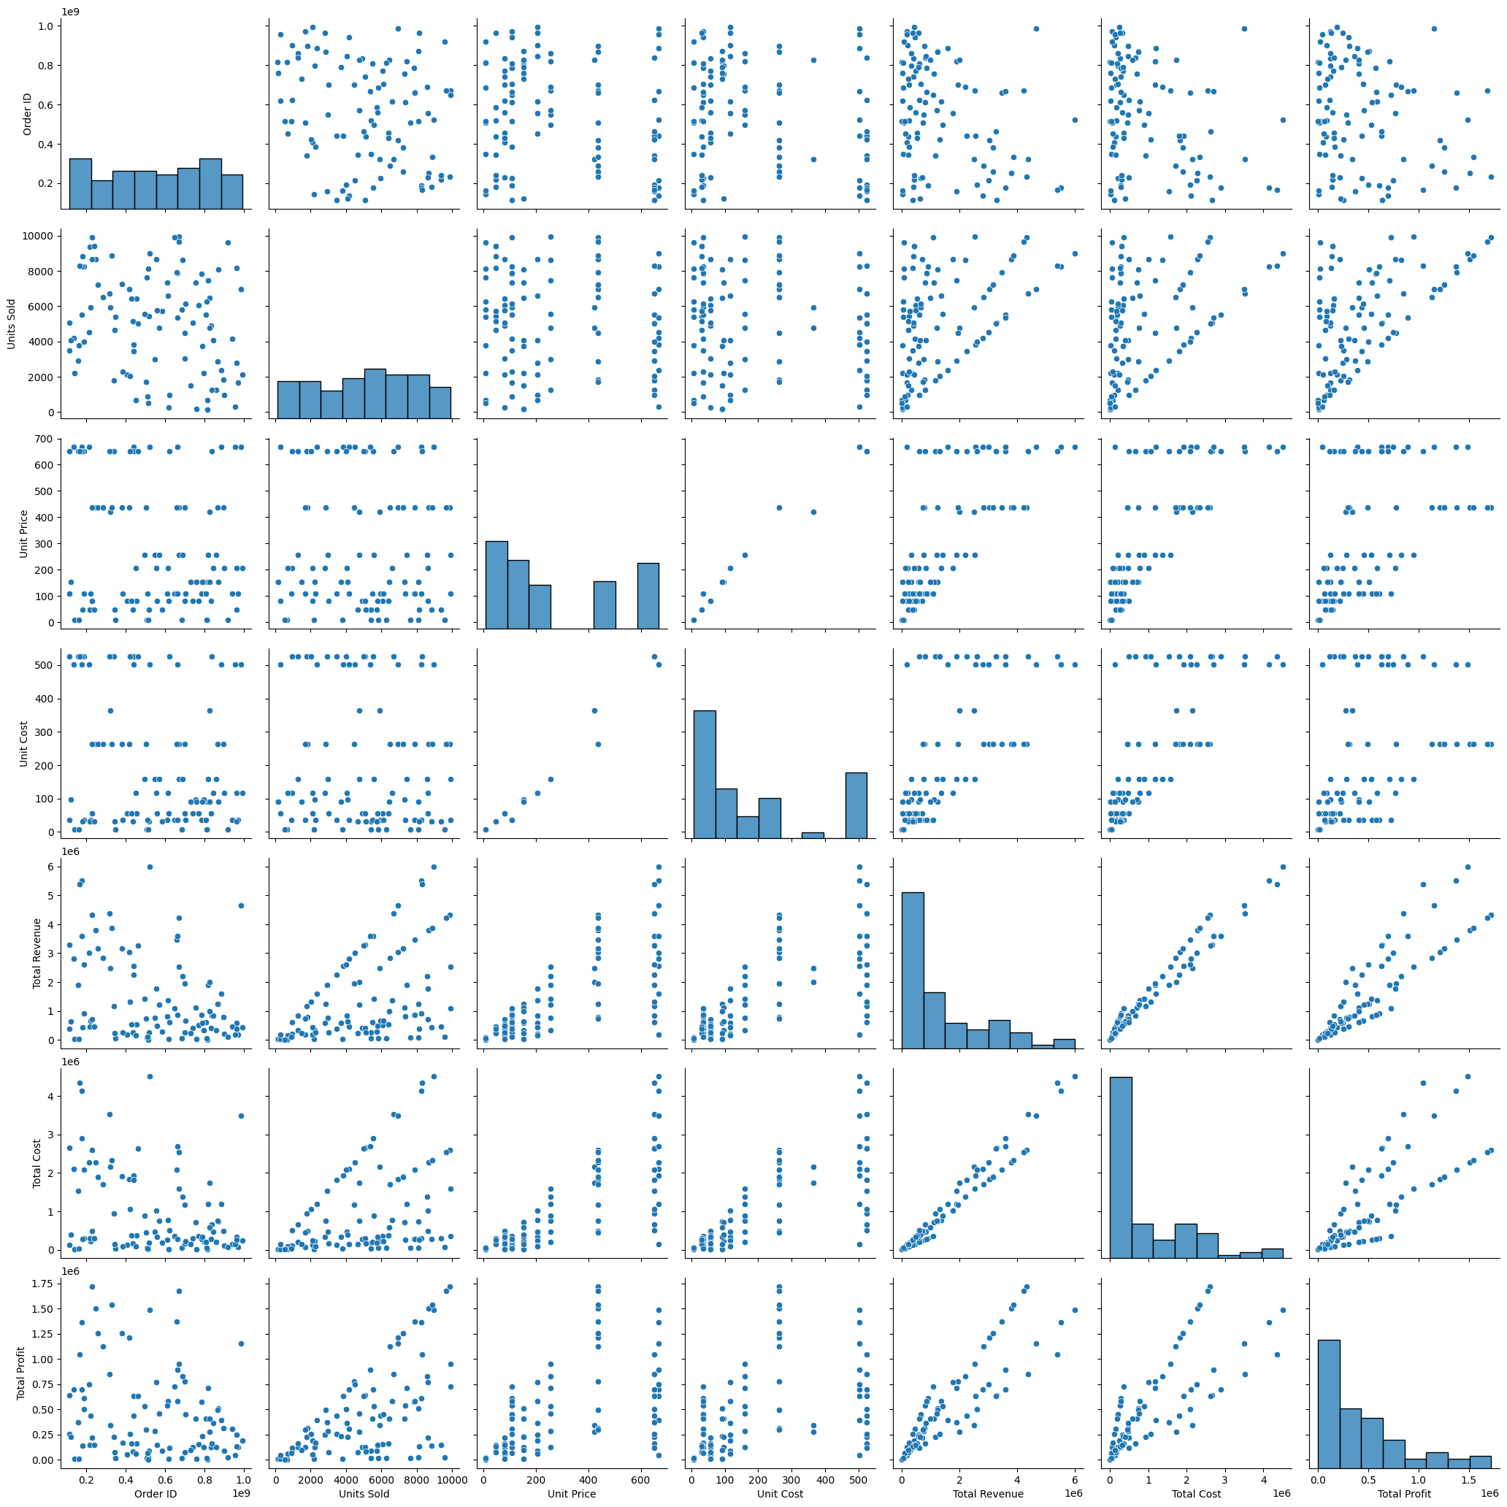
PAIR PLOT
This pair plot shows the distribution between the different columns of the Amazon Sales Data Set.

Slide 3
Statistical Data
Order ID | Units Sold | Unit Price | Unit Cost | Total Revenue | Total Cost | Total Profit
count | 1.000000e+02 | 100.000000 | 100.000000 | 100.000000 | 1.000000e+02 | 1.000000e+02 | 1.000000e+02
mean | 5.550204e+08 | 5128.710000 | 276.761300 | 191.048000 | 1.373488e+06 | 9.318057e+05 | 4.416820e+05
std | 2.606153e+08 | 2794.484562 | 235.592241 | 188.208181 | 1.460029e+06 | 1.083938e+06 | 4.385379e+05
min | 1.146066e+08 | 124.000000 | 9.330000 | 6.920000 | 4.870260e+03 | 3.612240e+03 | 1.258020e+03
25% | 3.389225e+08 | 2836.250000 | 81.730000 | 35.840000 | 2.687212e+05 | 1.688680e+05 | 1.214436e+05
50% | 5.577086e+08 | 5382.500000 | 179.880000 | 107.275000 | 7.523144e+05 | 3.635664e+05 | 2.907680e+05
75% | 7.907551e+08 | 7369.000000 | 437.200000 | 263.330000 | 2.212045e+06 | 1.613870e+06 | 6.358288e+05
max | 9.940222e+08 | 9925.000000 | 668.270000 | 524.960000 | 5.997055e+06 | 4.509794e+06 | 1.719922e+06

Slide 4
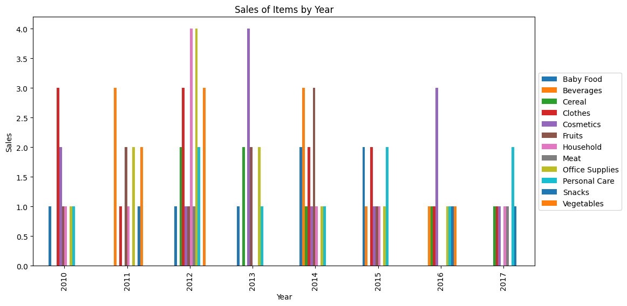
Sales of Items per Year.
As per the Order Date when we calculate the Years, there are 8 years given starting from 2010 to 2017.
So , from this graph we can observe the different Items sales in different years.

Slide 5
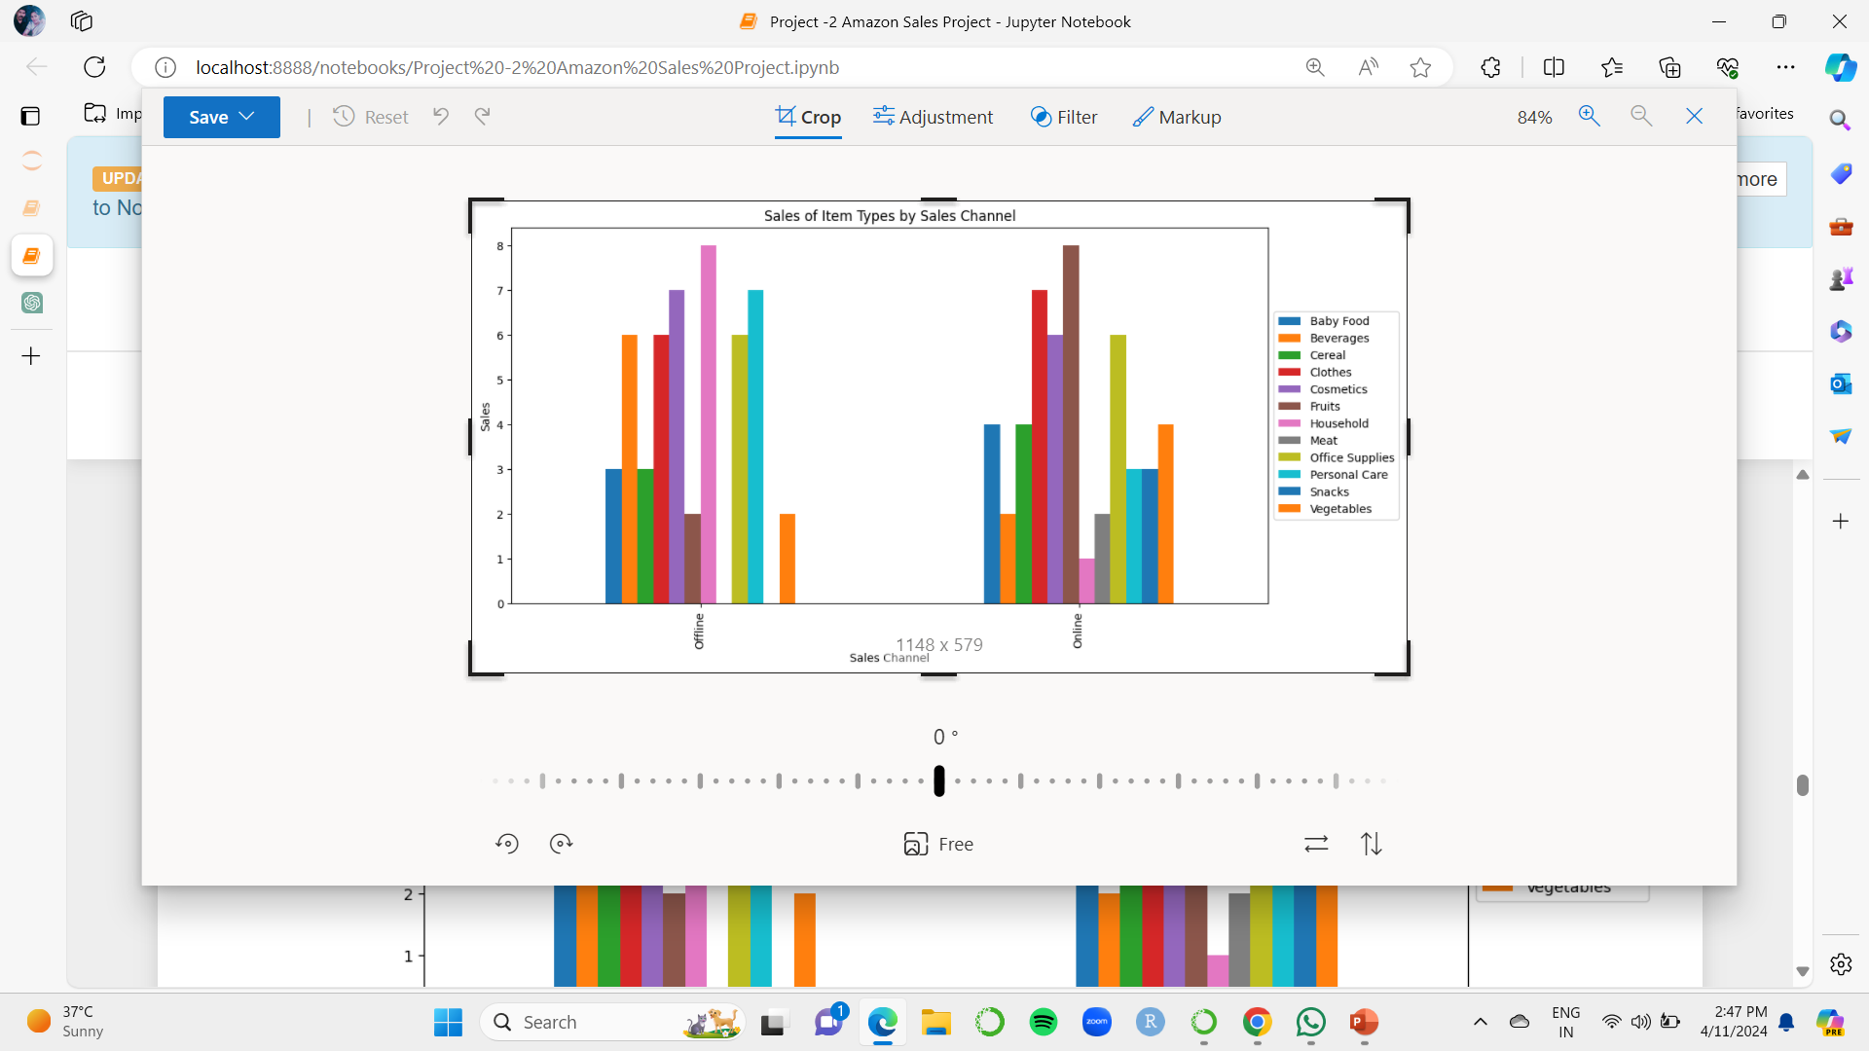
SALES CHANNELS vs ITEM TYPE

Slide 6
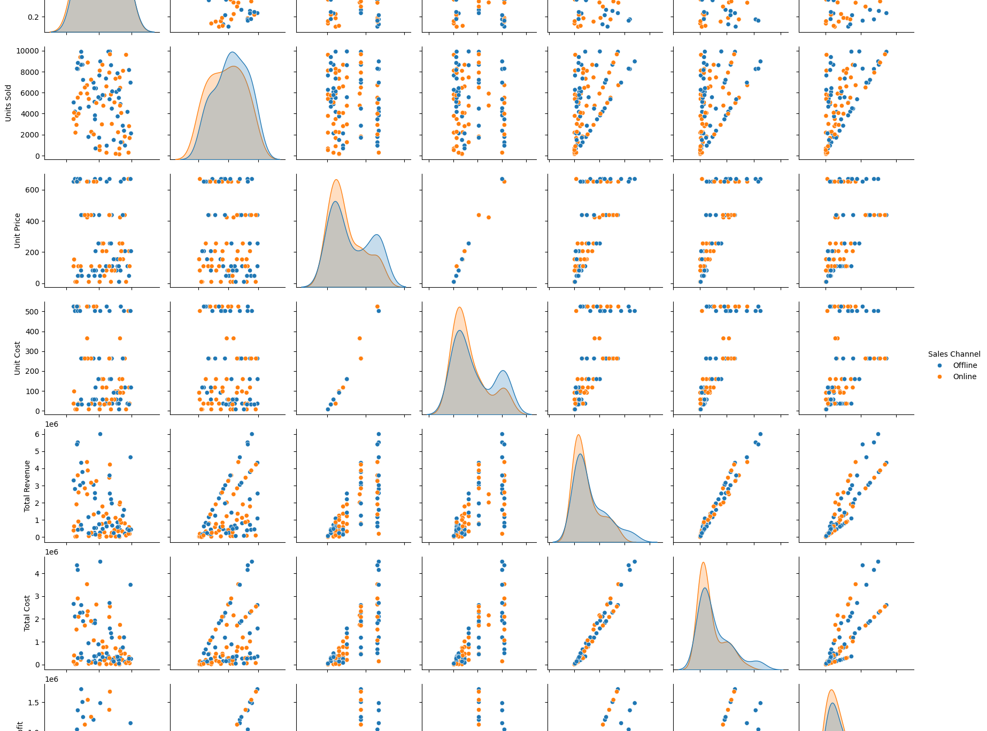
PAIR PLOT
This pair plot is based on the ‘Sales Channel’ of the data set. This sales channel has 2 categories i.e Online and Offline.

Slide 7
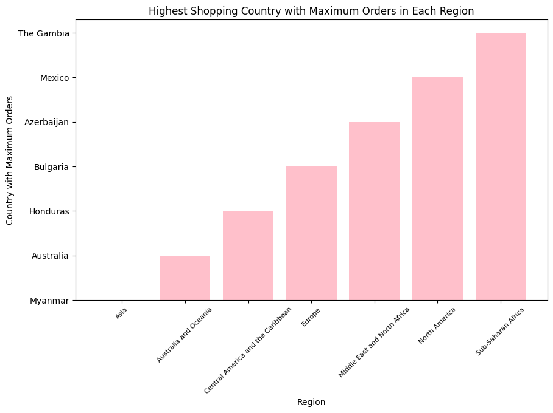
Regions & Countries.
There are 7 Regions with 76 countries.
This graph shows all the regions along with the countries that has highest purchasing of products.
X-axis of the graph shows the country with the maxium purchasing items.
Y-axis explains the different regions that the country belongs to.

Slide 8
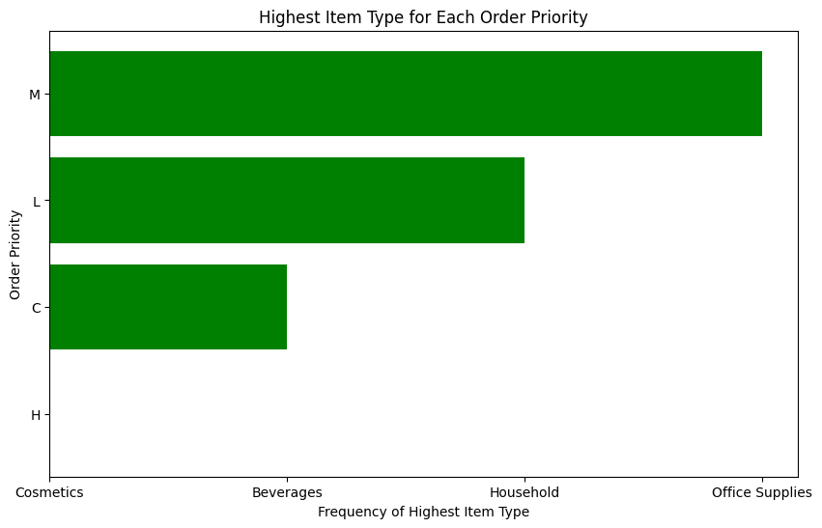
Order Priorities with Item Types
POINTS:
There are 4 order priorities like H,L,M,C.
H stands for High priority Item.
L stands for Low priority Item.
M stands for Medium priority Item
C stands for Critial Priority Item.

Slide 9
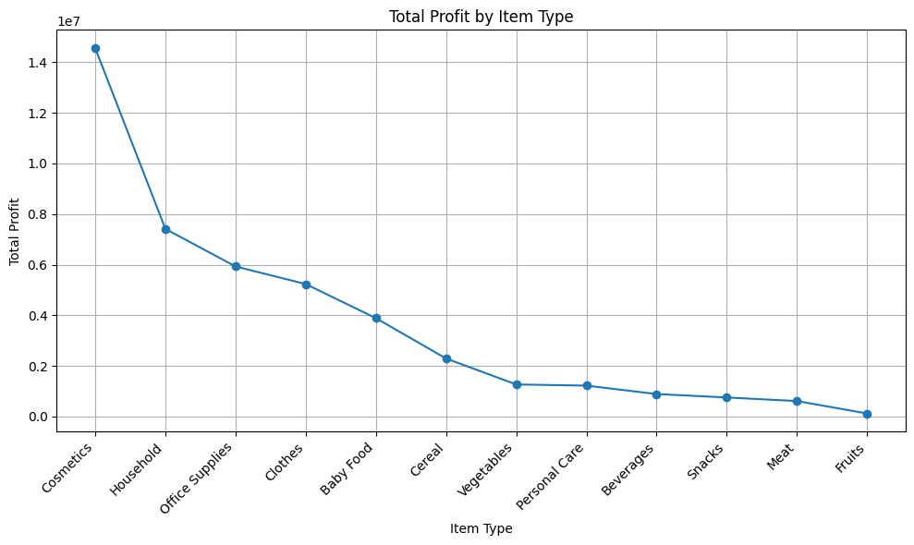
TOTAL PROFIT vs ITEM TYPE
This graph explains about the Total profits of each item that is sold by the amazon company in all the years.
As we know that there are 12 items in the given dataset. The highest profit is for Cosmetics and lowest profit is for Fruits.

Slide 10
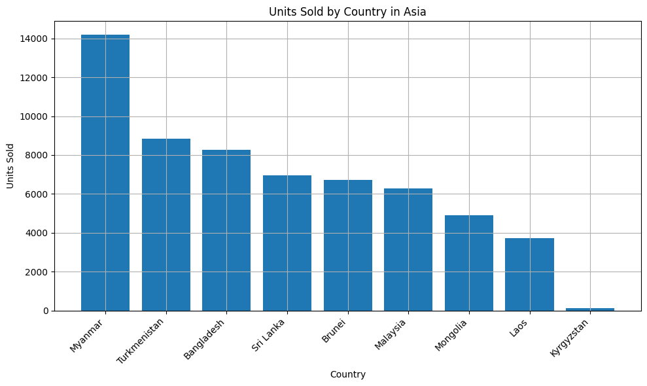
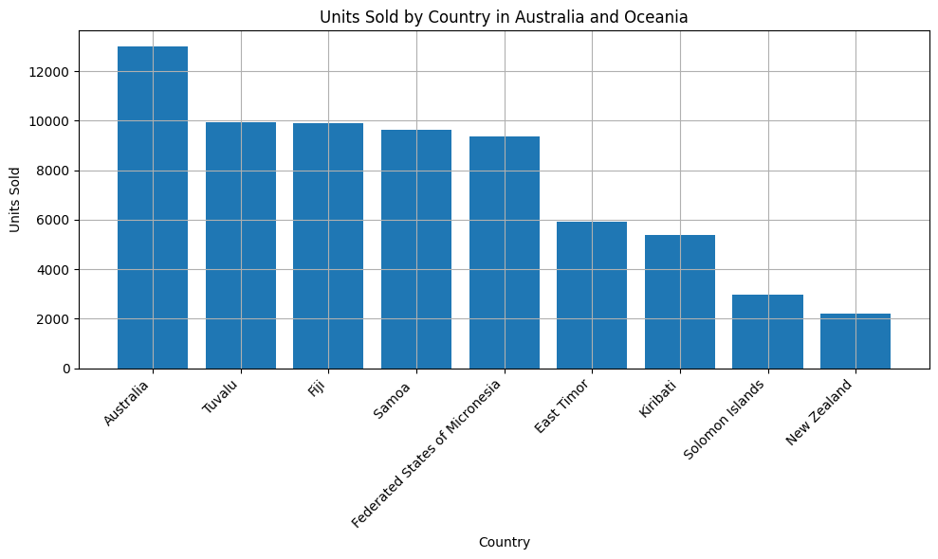
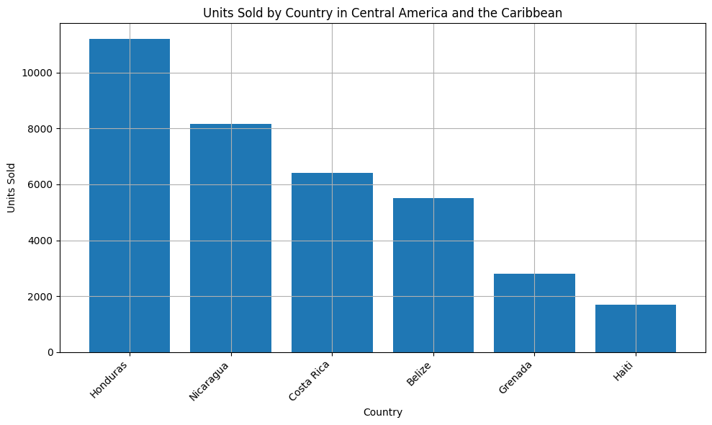
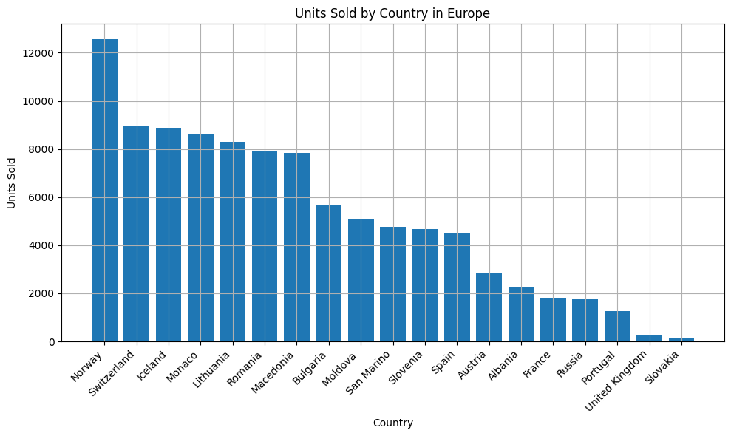
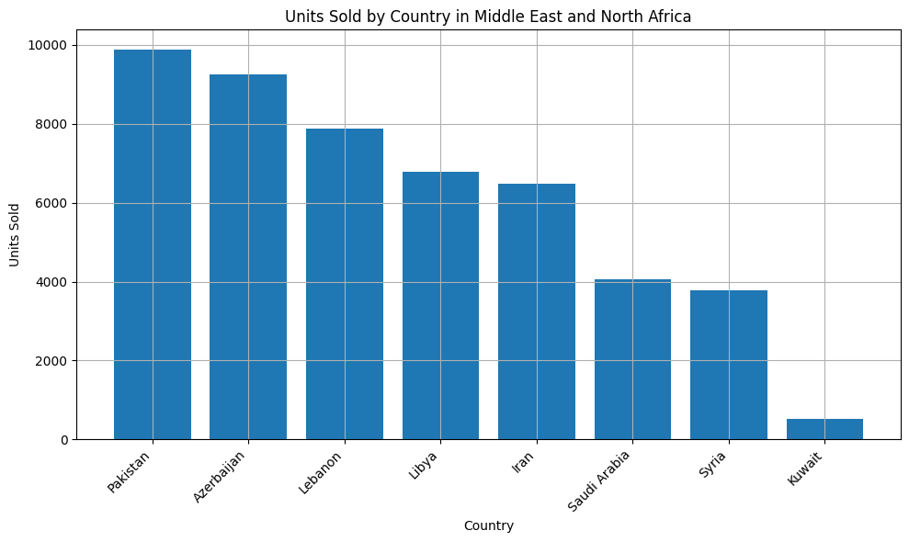
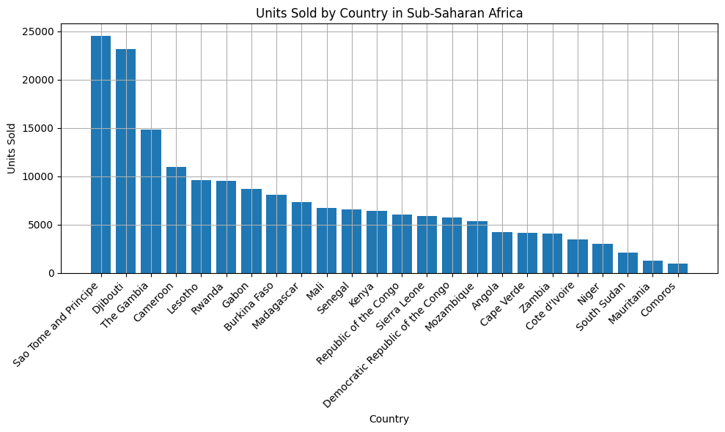
Dashboard

Slide 11

Thank you
Bhanu Devaguptapu
bhanudevaguptapu4@gmail.com

